Slide 1
Mount Seymour Little League AGM
December 1, 2015

Slide 2
Meeting Agenda
Welcome to MSLL AGM
Presidents Report
Nominate and Vote for Board Members
Open Q&A
Meeting Close

Slide 3
Welcome
Thank you for coming to the MSLL 2015 AGM
Please ensure that you have signed in and have a door prize ticket
Draw at end of the meeting (1 free 2016 registration, 4 Canadians tickets)

Slide 4
Registration 2015
501 players (49 player increase from 2014)
47 teams (6 more than in 2014)

Slide 5
Registration Last 5 Years

Slide 6
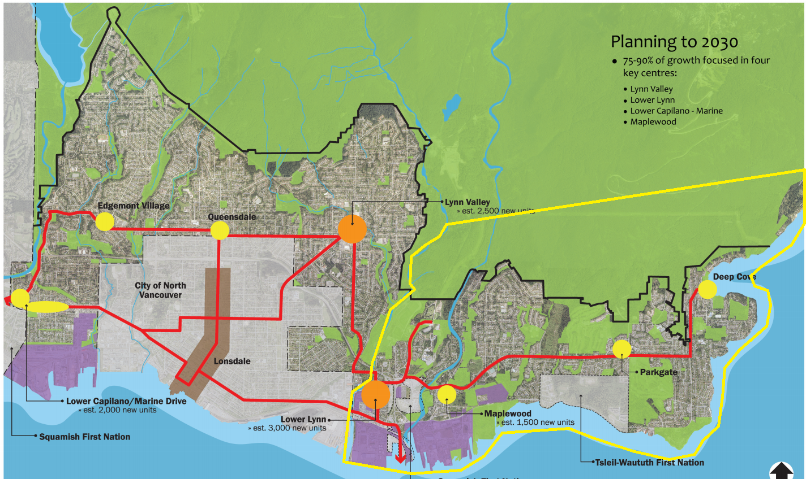
Population Growth within MSLL Boundary
DNV Official Community Plan includes significant growth in Seymour area
1500 new units at Maplewood Village
3000 new units at Lower Lynn Town Centre
Both areas are within MSLL boundary
Expect league numbers to continue growing

Slide 7
New in 2015
Opening ceremony for all teams held in early April
Changed AA max run limit to 3 instead of 5 for closed innings
Introduced catch up rule for closed innings in AA and AAA
Closing ceremony including running the bases for Rookie Junior and Rally Caps
Adapted divisions to accommodate new Little League Age Determination

Slide 8
Player/Coach Development Programs
Parkgate Winter training for 6-10 year olds (35 players)
New Fall/Winter training sessions at Inside Performance
  Very popular program – added extra session to accommodate waitlisted players
  6 sessions of 8 weeks across fall and winter for players from AA to Seniors
AA player skills and coach development clinics (all teams)
Teaching for Tomorrow clinic (attended by 58 coaches)
Majors players used as Mentor Coaches for the Rally Caps programs
Coach and Managers information folders provided to all Rally Caps teams

Slide 9
2015 Post Season Teams
9s – participated in Lynn Valley invitational tournament
9/10s – reached semi-finals in district tournament
Majors – 5th place in district tournament
Juniors – played in Provincials
Seniors – played in Provincials
Bigs – combined D5 team reached Canadian Nationals Final
Post season fees of $50/player were collected from all teams

Slide 10
Baseball in the Summer
New Super 8s team participated in NVC tournament
9/10s, Intermediate and Seniors teams played Whistler Tournament in July
9s team played additional tournament in Lynden
11s team – Eldon and Whalley Tournaments
Rookie Senior Summer Ball Program
  6 additional weeks (1 game + 1 practice per week)
  20 players

Slide 11
Baseball in the Fall
IP Fall Ball league did not run this season
MSLL was offered exhibition games – but we have no ballpark in the Fall
Fall skills training at IP (includes 2 IP pro coaches) Oct-Dec
  Level 1 (RS/AA) – 20 kids – 8 weeks – sold out in 24 hours, 4 players on waitlist
  Level 2 (AAA/Majors) – 20 kids – 8 weeks – also sold out

Slide 12
Baseball in the Winter
Winter skills training at IP (includes 2 IP pro coaches) Jan-Feb
  Level 1 (RS/AA) – 20 kids – 8 weeks
  Level 2 (AAA/Majors) – 20 kids – 8 weeks
  Juniors/Seniors – 15 kids – 8 weeks
Parkgate skills training*
  6/7/8 year olds – 30 kids – 8 weeks
  *Need coaches from this age group to volunteer to go ahead with this program
Player assessment for AA, AAA and Majors
  Windsor Gym Feb 13/14th, make-up session on Feb 15th Seycove

Slide 13
Communications – New Website
New MSLL website launched in March 2015
Built by Rene Michaely of Mountain Interactive
Uses modern Wordpress mobile friendly architecture
SportPress plugin used to manage teams, schedule, results and standings
New website is much easier to update and maintain
Includes information about Juniors, Seniors and Bigs
Online batting cage booking tool

Slide 14
Communications – Social Media
MSLL on Twitter and Facebook
  Twitter stream shown on www.msll.ca website so no twitter account required
  Updated regularly with important news, updates, photos, baseball tips etc
  @MSLL_Baseball and www.facebook.com/MSLLBaseball
  Commenting/liking MSLL Facebook posts will help us reach a wider audience
  Twitter feed is monitored regularly and can be used to send questions/feedback
Saw big increase in 2015 of parents engaging with MSLL on social media
  Facebook page likes 109
  Twitter followers 126

Slide 15
Fields and Safety
Added significant amount of dirt to Seycove field to improve base paths
Seycove field landscaping work done prior to start of season
Installed new netting on the Majors diamond bull pen
New score booth installed at Seycove field
DNV providing $27k Myrtle Park fencing upgrade prior to 2016 season
MSLL now using the online CRC process
  https://justice.gov.bc.ca/eCRC/home.htm (Access code LWUELZ7WVG)
  Can still get traditional CRC at RCMP office
  CRCs are valid for 3 years
Will offer St Johns First Aid course in March 2016 – exact date TBD

Slide 16
Equipment
MSLL dry-fit T-shirts provided to all players from RJ to Bigs
RJ and RS uniforms replaced with dry-fit team jersey that players kept at end of season
Many RJ/RS teams added player names to the team jerseys
Composite bats provided to all Majors teams for regular season
New All Star uniforms for Majors division
New composite bats provided for post season teams
Equipment modernization program continues, with the culling and replacement of outdated equipment
Management of the pant inventory continues
New equipment storage containers at Kirkstone and Inter River

Slide 17
2015 Survey Results
End of season surveys sent to all divisions in MSLL:
  Rally Caps-Majors – 51% responded
  Juniors, Seniors, Bigs – 21% responded
  Overall – 45% response rate
68% Very Satisfied with overall MSLL season
94% Happy with Coaching their child received
98% Cost is About Right (or too low)
83% Very Likely to register with MSLL next season
Survey results will be available on www.msll.ca website soon

Slide 18
Little League Age Change (Again)!
Little League International voted in October to once again change the age determination date
Baseball age will now be determined by players age on August 31st
This change is immediate for all players born after Sept 1st 2005
Players born before August 31st 2005 will continue using April 30th date until 2018
In 2018 all players* will change to using August 31st date
Players born between 1 May 2005-31 August 2005 will not change until 2019 season

Slide 19
What Age Change Means for MSLL
MSLL will continue to place players in Rally Caps, Rookie Junior and Rookie Senior by school grade not by baseball age:
  Rally Caps (Pre-K and Kindergarten)
  Rookie Junior (Grade 1)
  Rookie Senior (Grade 2)
Baseball age and skills assessment will be used to place players in AA and higher divisions

Slide 20
Financial Summary
MSLL would like to thank Lori Ireland who stepped down this Spring after many years as MSLL treasurer
Due to the transition the 2015 accounts were prepared by an external accountant
We would like to thank Jean Paul Borgen for volunteering his time to help MSLL
Some income/expense classification may vary due to the change of accountant

Slide 21
Financial Objectives in 2015
MSLL started the 2015 season with a balance of $119,780
League is not eligible to apply for any gaming grants due to available funds
Executive set a budget for 2015 with the intention to invest additional money into lasting improvements for the entire league

Slide 22
Financials - Income
Registration income increased by $10k to $86,820
This includes amounts received for IP fall/winter training sessions (~$13k)
Spring registration income was therefore lower than previous season
  50 more players registered than in previous season
  Rally Caps fees reduced from $155 to $120 to encourage young players to join
Concession income ($8,212) was lower than previous season ($10,062)
Sponsorship income ($2,600) increased from ($1,000)
Total income increase of $9,328 over previous season

Slide 23
Financials - Expenses
Administrative Expenses increased marginally from $14,708 to $15,522
  Increased bank charges
  Minor increase in insurance fees
  Minor increase in advertising fees
Operating Expenses increased from $69,839 to $98,139

Slide 24
Financials – Operating Expenses
Uniforms and Equipment
  Increase of $6,786 over previous season
  Equipment modernization program continued with culling of out-dated equipment
  Uniform increase partially due to additional registrations
  RJ and RS uniforms replaced with dry-fit team jersey that players kept at end of season
  New all star uniforms purchased for the Majors division
  Composite bats provided for all Majors regular season teams
  New composite bats purchased for post season teams
  New gear bags purchased for all teams
  New storage container built and installed at Inter-River park

Slide 25
Financials – Field Improvement
Field Improvement and Equipment
  Increase of $5,968 over previous season
  Significant cost for field improvement work done on Seycove diamond
    Field trimming, reseeding, base path dirt etc
  Replacement of the netting on the Majors diamond bull pen
  New score booth built and installed at Seycove diamond
  Purchase of new rakes and replacement locks

Slide 26
Financials – Coaches/Players
Coach/Player Training
  Total expenses of $14,001 payed to Inside Performance for 6 fall and winter training sessions offered to players aged 8 to 16
  Training programs were offered at break even cost
  Income within player registrations amount covered the cost of the IP training
Field Permit
  Sport BC increased the field levy fee resulting in an increase of $3,186 for our field permit

Slide 27
Financials – Other
$1,200 cost for implementation of new MSLL website
Trophies cost increased due to additional player registrations
Gym rental fees for assessments were higher this year
$1,250 charge for Lions Club BBQ on Photo Day
Umpire fees slightly increased due to increased registrations
Umpire/coach training fees higher due to increased registrations

Slide 28
Financials – Summary
MSLL ended 2015 with a closing balance of $104,230
MSLL Executive will continue to look at ways to invest in the future of the league to the benefit of all players

Slide 29
Volunteers for Executive 2016
President: Jasmine Barry*
Vice President: Daryl Townsend
Treasurer: Jennifer Dickson*
Registrar: Connie Cunningham
Secretary: Cathy Brydon*
Player Agent: Yvonne Leonard*
Coaching Director: Steve Armistead*
Past President: Tom Murphy
Umpire in Chief: Todd Dea
Equipment: Warren Wightman
Safety: Bruce Davis
Communications: John Edmonds
Fields: Darren Embley*

Slide 30
Board Members
MSLL Board is an over-sight group to monitor the actions of the Executive
Board members approve the Executive nominees for upcoming season
New in 2016: board members attend 2-3 Executive meetings as observers
Action: Nominate board candidates
Action: Vote for board members
Notes:
Danny Filippone
Howard Blaney?

Slide 31
Questions?

